Slide 1

Final Project Presentation
Student Registration System
UAGC CST499
Capstone Project
Prepared by:
Nikko Amaya

Slide 2
Overview of the SRS Document
Purpose
The Software Requirements Specification (SRS) defines the functional and nonfunctional requirements for the Online Course Enrollment System. Its primary goal is to guide the design, development, and testing of a secure, user-friendly platform where students can manage all aspects of course registration.
Project Scope
This system enables students to:
Create accounts with unique IDs and secure passwords
Manage personal profiles (name, phone, email, etc.)
Browse courses offered by semester (spring, summer, fall)
Enroll in available courses with real-time tracking
Join waitlists for full courses and receive automatic notifications
Cancel enrollments, triggering waitlist updates

Slide 3
Overview of the SRS Document
3. Product Features Core functional requirements include:
User Registration & Profile Management – Secure account creation and profile storage
Authentication – Validation of credentials with meaningful error messages
Course Browsing – Filtered listings by semester with course details and capacities
Enrollment Management – Enrollments capped by maximum capacity
Waitlist Functionality – Queue-based management with automated email notifications
Enrollment Cancellation – Real-time seat updates and automatic promotion of waitlisted students
4. User Classes & Characteristics
Students: The primary users, requiring simple, intuitive interfaces
Administrators: Manage courses, policies, and enrollment capacities (with role-based permissions)

Slide 4
Overview of the SRS Document
5. Operating Environment & Constraints
Web-based, accessible via modern browsers (Chrome, Firefox, Edge, Safari)
Compatible with both desktop and mobile devices
Built to comply with FERPA-like academic data privacy standards
Developed with scalability, maintainability, and accessibility (WCAG 2.1 AA) in mind
6. Nonfunctional Requirements
Performance: Support 100+ concurrent users; pages load within 2 seconds
Security: Encrypted connections (HTTPS), hashed passwords, secure sessions
Reliability: Daily backups, ACID-compliant database integrity
Usability: Responsive, intuitive interface requiring minimal training
Maintainability & Scalability: Structured code and modular architecture for future growth

Slide 5
Overview of the SRS Document
7. Data & Database Requirements
Relational database supporting users, courses, registrations, and waitlists
Data integrity ensured through normalization and ACID compliance
Regular backups and failover mechanisms
8. Future Enhancements
Integration with institutional LMS/SIS systems
Alternative notification methods (e.g., SMS)
Expanded reporting and analytics for administrators

Slide 6
UML Design Model
Purpose and Design Intent
The UML artifacts define how the system behaves and how the parts fit together. They turn the SRS into a concrete blueprint that developers and testers can follow. This model emphasizes clear user flows, strict capacity rules, and reliable notifications, while keeping the architecture modular for easy maintenance and growth.

Slide 7
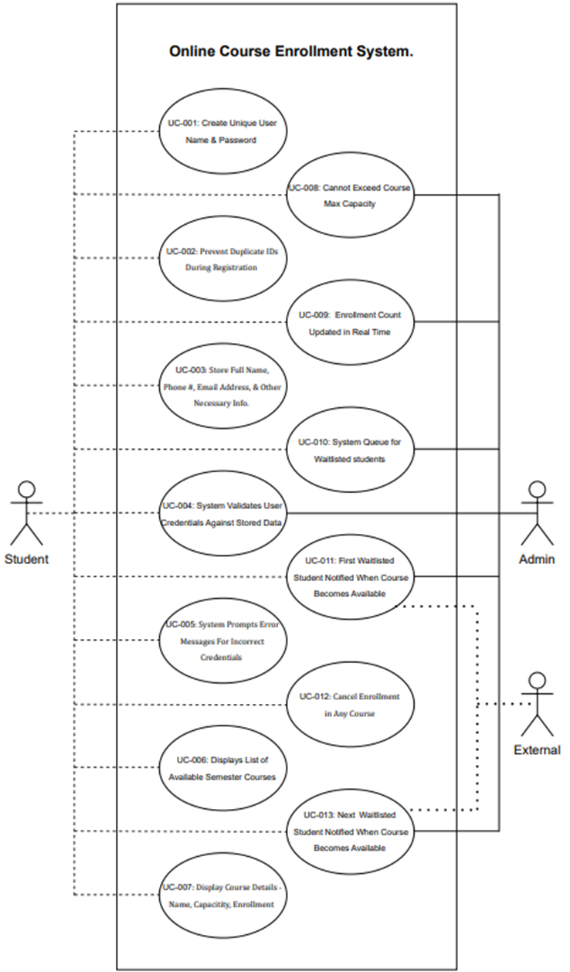
UML: USE CASE DIAGRAM
Goal: capture what users need to do and how they interact with the system.
Primary actors
Student: Registers, logs in, browses courses by term, enrolls, joins waitlists, cancels enrollment, views schedule.
Administrator: Manages course offerings, capacities, and terms.
Key use cases
Register Account and Login with validation and friendly error messages
Browse Courses by Semester with current capacity and enrollment
Enroll in Course with real time capacity enforcement
Join Waitlist and receive notifications when seats open
Cancel Enrollment with automatic waitlist promotion
Manage Courses for admin use in future releases
Quality attributes captured by the model
Simplicity in the student journey
Strong validation at each step

Slide 8
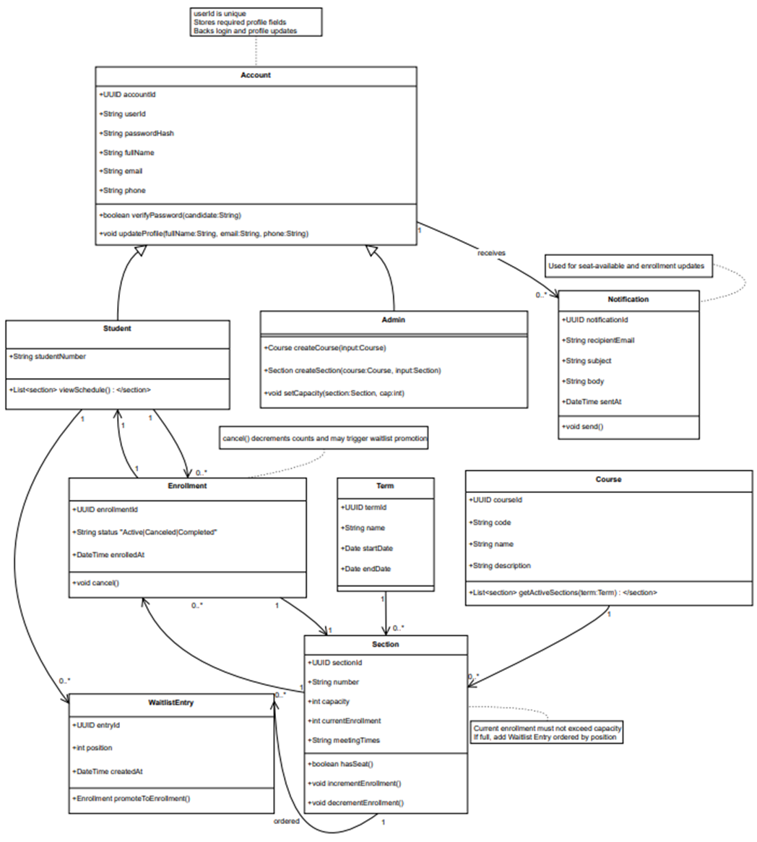
UML: CLASS DIAGRAM
Class Diagram – Key Elements
Core Entities
Account & Student: credentials, profile details
Course & Section: course info, term-specific capacity tracking
Enrollment: links students to sections
WaitlistEntry: ordered queue for full courses
Notification: confirmations and waitlist updates
Service Layer
AuthService: registration & login
CourseCatalog: queries courses/sections
RegistrationService: handles enrollments, cancellations, waitlist promotion
Persistence Layer
- AccountStore, SectionStore, EnrollmentStore, WaitlistStore: manage database operations
Relationships & Constraints
One student → many enrollments
One section → many enrollments & waitlist entries
Enrollments blocked if section is full
Waitlist promotion triggers automatic notifications
Design Benefits
Clear separation of concerns
Easy to test & maintain
Supports scalability & future LMS/SIS integration

Slide 9
Landing, Login, and Enrollment Pages
Purpose
These pages form the front-end entry point to the system. They allow new students to register, existing students to log in, and all users to access course enrollment functions. Their design emphasizes usability, security, and smooth navigation.
Developed key front-end pages using PHP, HTML, and CSS:
Landing Page – Entry point with navigation options
Login Page – Secure authentication for existing users
Registration Page – New users create accounts with full name, email, phone, and password
Designed with usability, clarity, and security in mind

Slide 10
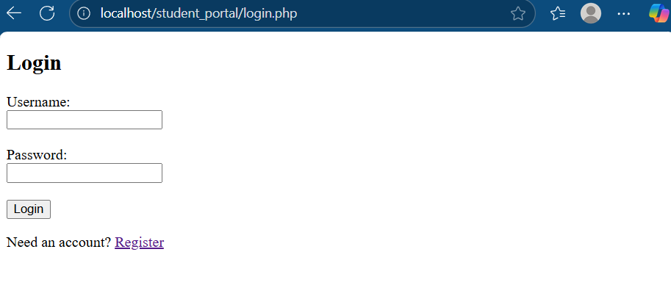
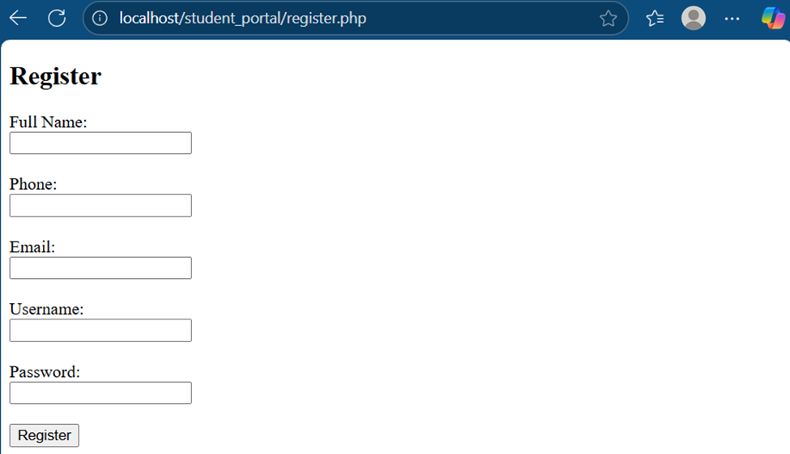
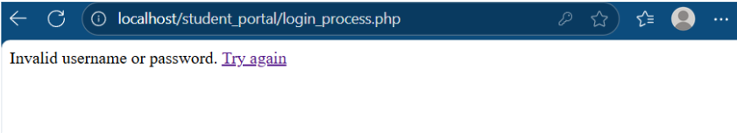
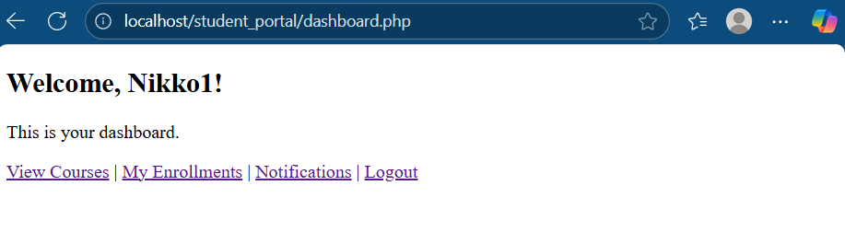
Landing, Login, and Enrollment Pages
Notes:
Landing Page
Acts as the gateway to the system.
Provides navigation to registration or login.
Designed for clarity and simplicity, ensuring first-time users can quickly find what they need.
Login Page
Enables secure access for existing users.
Credentials validated against stored data in the MySQL database.
Includes error handling for incorrect IDs or passwords.
Protects student data through hashed passwords and secure sessions.
Registration Page
Collects essential user details: full name, email, phone, and password.
Enforces unique email/ID constraints to prevent duplicates.
Uses client-side (HTML5) and server-side (PHP) validation to ensure proper data formats.
Passwords secured with PHP’s password_hash() function before database storage.
Design Considerations
Developed with PHP, HTML, and minimal CSS for structure and accessibility.
Emphasis on usability and accessibility (clear labeling, simple forms, responsive layout).
Integrated with backend PHP scripts for data validation and storage.
Outcome
Provides a clear workflow: students land → register/login → access enrollment.
Establishes the foundation for all other functionality (course browsing, registration, waitlisting).
Ensures a secure and professional user experience from the start.

Slide 11
MySQL Database and Class Registration
Purpose
The database is the backbone of the system, ensuring that all student, course, and enrollment data is stored securely and updated consistently. It supports account management, registration, waitlisting, and schedule tracking.
Database created using MySQL and phpMyAdmin:
Users Table – Stores student details (ID, fullname, email, phone, password)
Courses Table – Contains course information and capacity
Registrations Table – Tracks student-course relationships
Supports class registration, listing, adding, and deleting courses

Slide 12
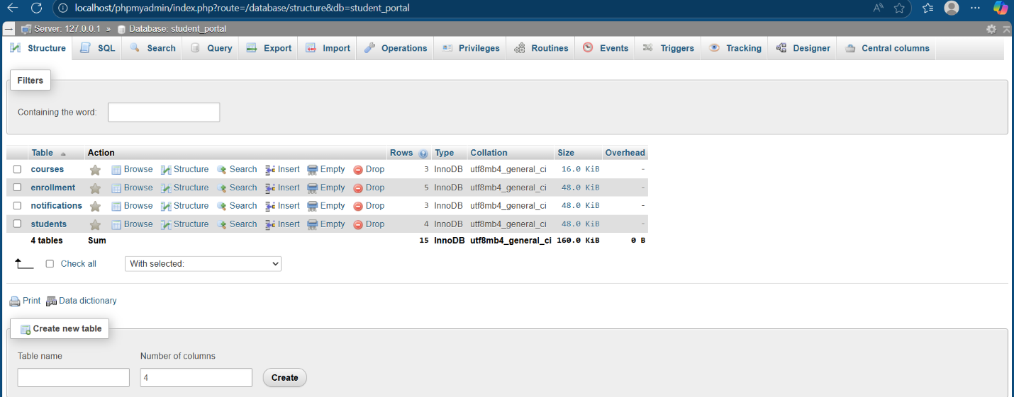
MySQL Database and Class Registration
This screenshot shows the student_portal database in phpMyAdmin, which contains four core tables:
courses – Stores course details such as ID, name, capacity, and enrollment.
enrollment – Tracks student registrations, linking users to their selected courses.
notifications – Manages system-generated alerts (e.g., enrollment confirmations, waitlist updates).
students – Holds student profile and authentication details (name, email, phone, password).
Together, these tables form the foundation of the registration system, ensuring data integrity and supporting all major functions like enrollment, waitlisting, and notifications.

Slide 13
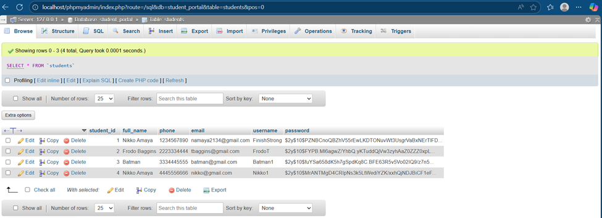
MySQL Database and Class Registration
The students table stores core information for all users of the system.
student_id – unique primary key for each student.
full_name, phone, email – personal contact details.
username, password – credentials for authentication (passwords are securely hashed).
This table is the foundation of account management, ensuring each student has a unique identity and secure access to the system.

Slide 14
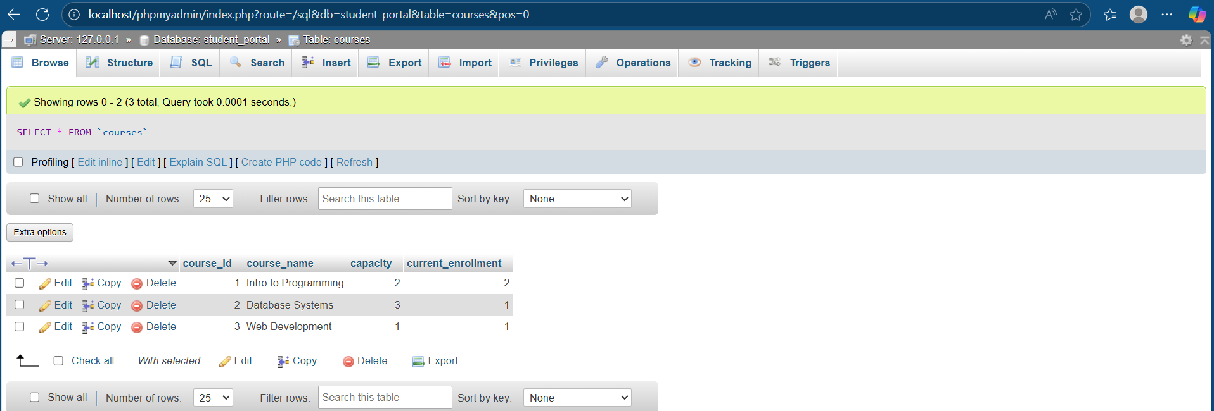
MySQL Database and Class Registration
The courses table contains details of all classes available for registration.
course_id – unique identifier for each course.
course_name – name of the course (e.g., Intro to Programming).
capacity – maximum number of students allowed.
current_enrollment – tracks how many students are currently registered.
This table ensures real-time tracking of course availability, enabling accurate enrollment limits and waitlist management.

Slide 15
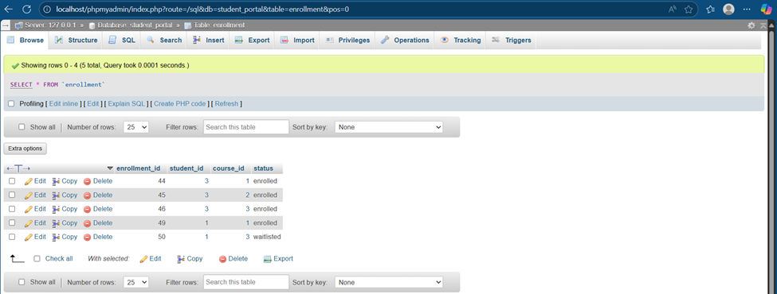
MySQL Database and Class Registration
The enrollment table records each student’s course registrations.
enrollment_id – unique identifier for each registration record.
student_id – links the enrollment to a student.
course_id – links the enrollment to a course.
status – indicates enrollment state (enrolled or waitlisted).
This table is central to the registration workflow, ensuring:
- Students are properly linked to their chosen courses.
- Capacity rules are enforced.
- Waitlist functionality operates smoothly.

Slide 16
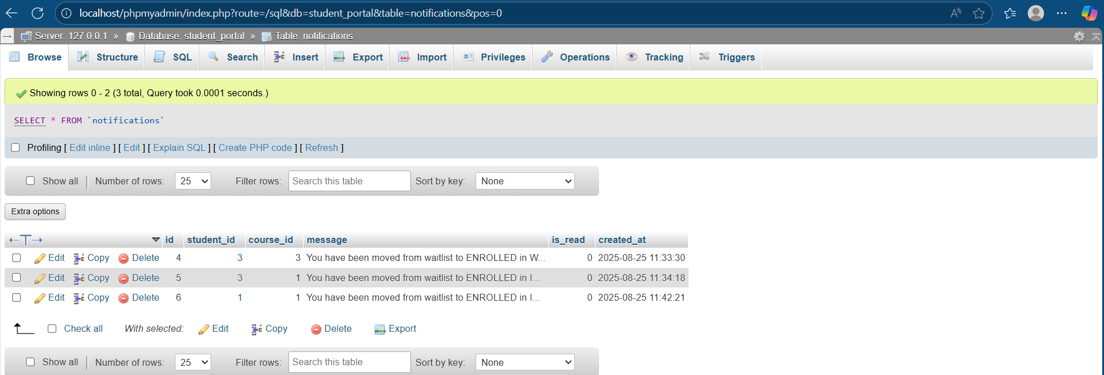
MySQL Database and Class Registration
The notifications table tracks system-generated alerts for students.
id – unique identifier for each notification.
student_id – identifies the recipient of the message.
course_id – links the message to a specific course.
message – describes the event (e.g., moved from waitlist to enrolled).
is_read – marks whether the student has seen the notification.
created_at – timestamp of when the notification was generated.
This table ensures students receive timely updates, such as:
- Enrollment confirmations.
- Waitlist promotions.
- Course status changes.

Slide 17
PHP Code Development
Purpose of the PHP Code in this Project
PHP is the application layer that turns the SRS and UML models into a working system. It handles the server side logic behind every student action, connects the web pages to MySQL, enforces business rules like capacity and waitlists, protects data through authentication and validation, and keeps the database in a consistent state.
register.php: Presents the new account form for full name, email, phone, username, and password. Uses basic HTML validation and posts to register_process.php.
register_process.php: Validates and sanitizes input, checks for duplicate email or username, hashes the password with password_hash, inserts the student into students, then redirects to the login page with a success message or back to the form on error.
login.php: Simple login form for username and password with gentle error display. Posts to login_process.php.
login_process.php: Looks up the user by username or email, verifies the password with password_verify, starts the session and stores user context, then redirects to dashboard.php on success or returns to login.php with a generic error.
dashboard.php: First page after authentication. Requires a valid session, shows recent notifications and quick links to Courses, My Enrollments, Notifications, and Logout.
courses.php: Lists all courses with capacity and current enrollment from courses. Shows an action to enroll or join the waitlist based on available seats, sending the selected course_id to enroll.php.

Slide 18
PHP Code Development
enroll.php: Core enrollment action. Requires session and a valid course_id, prevents duplicate enrollments for the same course, checks capacity, inserts an enrollment row as enrolled or waitlisted, updates counts consistently, creates a notification, and redirects back to Courses or My Enrollments.
my_enrollments.php: Actionable schedule view for the logged in student. Joins enrollment with courses to list course names and status, provides a Cancel button that posts the enrollment_id to cancel_enrollment.php.
enrollments.php: Read only schedule view showing each course and current status for the student. Useful if you want a simple list without actions.
cancel_enrollment.php: Cancels an enrollment owned by the current student, updates course counts, looks up the next waitlisted record for that course, promotes it to enrolled if present, inserts the appropriate notifications, then returns to My Enrollments.
notifications.php: Student inbox for system messages. Lists notifications with timestamps, supports marking one or all as read, and helps students track events like enrollment confirmations and waitlist promotions.
logout.php: Ends the session, clears session data, and redirects to login.php.

Slide 19
Conclusion
Overall, this project transformed a complete requirements set into a reliable web application for course enrollment. The SRS defined what to build and the UML design showed how each part fits together. The interface guides students from landing to registration and enrollment, while PHP enforces the rules for capacity, duplicate prevention, and ordered waitlists. A structured MySQL database keeps data accurate and supports timely notifications. Testing at multiple levels validated function, performance, and usability. The result is a secure and maintainable system that meets the stated project requirements and is ready to expand with administrative tools, integrations, and reporting.

Slide 20
THANK YOU for VIEWING

